Slide 1
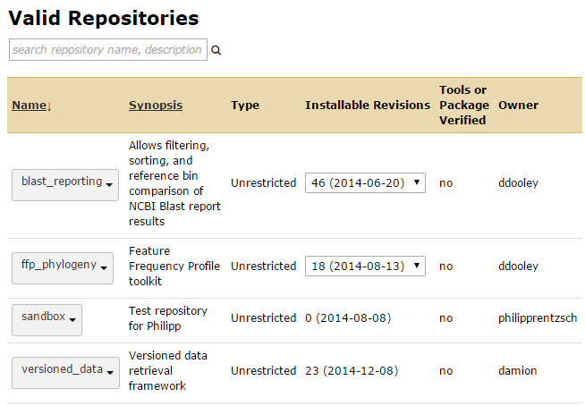
Sharing your Galaxy tool with the world
This involves uploading the tool files into a Galaxy "toolshed" where a Galaxy admin can select it for installation at their own location.
Created by Damion Dooley, Hsiao lab, BC Public Health Microbiology & Reference Laboratory,
BC Centre for Disease Control, https://github.com/Public-Health-Bioinformatics

Slide 2

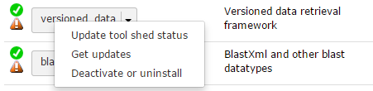
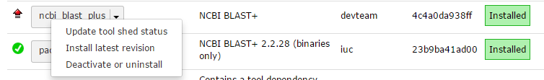
Galaxy Tool – Versioning
Every tool should have a version number.
<tool id=”blast_reporting” name=”BLAST Reporting” version=”1.0.5”>
Incrementing the version number causes a toolshed (and Galaxy) to treat the uploaded tool version as its own entity, like a new model of a car that can be taken out for a drive.

Slide 3
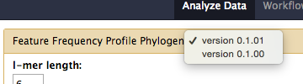

Galaxy Tool – Versioning
With a few tool version installed on a Galaxy server, a user will have a choice of which to run.
If version number stays the same: the upload becomes an update to the existing toolshed version (same car). If a Galaxy admin downloads your changes they will be applied to their currently loaded tool (if same version).
Uploads to main Galaxy toolshed should include a version number increment, i.e. try to limit uploads to significant changes.
Mask of Yul Brynner, Westworld (1973)

Slide 4
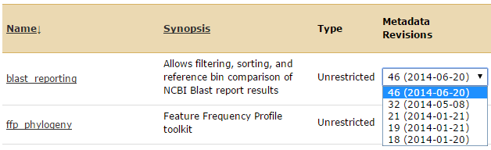
Galaxy Tool – Version Id
Note: The Galaxy toolshed “Revisions” list is a bit odd in that it lists off its own item record id and upload date, but doesn't list the tool's version id. (View its record to see this).

Slide 5
Preparing a Toolshed Update
Make a tar archive of the tool folder contents for upload to a toolshed.
Select which files or subfolders to include or exclude in the archive. E.g. include all files except text editor backups, compiled python templates, and planemo output reports:
tar -zcvf [tool name].tar.gz * --exclude "*~" --exclude "*.pyc" --exclude "tool_test_output*" --exclude "*.gz"
Download to your local computer so that it can be uploaded to a Galaxy toolshed. The last “./” places the file in your current folder.
scp [your user name]@[your server name]:\ /usr/local/galaxy/galaxytest/galaxy-dist/tools/TESTING/[folder]/[tool name].tar.gz ./

Slide 6
Links
https://wiki.galaxyproject.org/ToolShed/PublishTool

